Slide 1
CCBD Assignment:
Bengaluru’s greenest part
TEAM BC_057_290_416

Slide 2
About our project
Our project aims to segregate areas of Bangalore into two categories - those with over 50% greenery and the rest using satellite images.
In order to implement this, we have used OpenCV (for identifying green areas in satellite images) for image processing and Hadoop map reduce for counting the number of areas with over 50% green cover.

Slide 3
OpenCV

Slide 4
Libraries used
We have numpy, cv2(for image processing) and argparse (for command line arguments) libraries in our program to identify green parts in a satellite image

Slide 5
import numpy as np
import argparse
import cv2

Slide 6
It is presumed that this python program will be run with the image file mentioned as a command line argument
The expected format is
python3 color.py —image <picture_name>
We will store the arguments in the variable args and the image in the variable img.
To load the image, we use a cv2 function imread

Slide 7
import numpy as np
import argparse
import cv2
ap = argparse.ArgumentParser()
ap.add_argument("-i", "--image", help = "image path")
args = vars(ap.parse_args())
img = cv2.imread(args[“image”])

Slide 8
We now need a reference rgb value so that our program can compare the rgb values of each pixel with the reference value to identify the green parts
Using a color-picker, the rgb value of a green part was taken from a satellite image
We’ll store that value in the variable called green.

Slide 9
import numpy as np
import argparse
import cv2
ap = argparse.ArgumentParser()
ap.add_argument("-i", "--image", help = "image path")
args = vars(ap.parse_args())
img = cv2.imread(args[“image”])
green = [50,70,60]

Slide 10
We now define sensitivity as 49 which has been chosen as a result of trial and error with many values.
We shall store that value in a variable called diff
Now, we need to define an interval of values that would act as a filter for pixels with a green shade.
The lower bound is defined as the reference rgb values subtracted by the sensitivity
The upper bound is defined as the reference rgb values added with the sensitivity
We will store these bounds as lists in a tuple called boundaries.
Since OpenCV represents images as numpy arrays in reverse order, the values stores will be in the order of bgr, instead of rgb

Slide 11
import numpy as np
import argparse
import cv2
ap = argparse.ArgumentParser()
ap.add_argument("-i", "--image", help = "image path")
args = vars(ap.parse_args())
img = cv2.imread(args[“image”])
green = [50,70,60]
diff = 49
boundaries = [([green[2] - diff, green[1] - diff, green[0] - diff], [green[2] + diff, green[1] + diff, green[0] + diff])]
lower = boundaries[0][0]
upper = boundaries[0][1]
lower = np.array(lower, dtype="uint8")
upper = np.array(upper, dtype=“uint8")

Slide 12
We shall now use the inRange function to loop over the image and check the rgb values of each pixel
The inRange function expects three arguments- the image to be processed, the lower limit of the color we want to detect, and the upper limit
It returns a binary mask with white pixels(255) representing green areas and black pixels(0) representing other areas

Slide 13
import numpy as np
import argparse
import cv2
ap = argparse.ArgumentParser()
ap.add_argument("-i", "--image", help = "image path")
args = vars(ap.parse_args())
img = cv2.imread(args[“image”])
green = [50,70,60]
diff = 49
boundaries = [([green[2] - diff, green[1] - diff, green[0] - diff], [green[2] + diff, green[1] + diff, green[0] + diff])]
lower = boundaries[0][0]
upper = boundaries[0][1]
lower = np.array(lower, dtype="uint8")
upper = np.array(upper, dtype=“uint8”)
mask = cv2.inRange(img, lower, upper)

Slide 14
To calculate the percentage of pixels with green color, we simply calculate the ratio of white pixels in the binary mask to the total number of pixels in the image
To find the total number of pixels in the image, we do img.size / 3
We divide by 3 because img.size yields the number of pixels times the number of channels, which is 3.

Slide 15
import numpy as np
import argparse
import cv2
ap = argparse.ArgumentParser()
ap.add_argument("-i", "--image", help = "image path")
args = vars(ap.parse_args())
img = cv2.imread(args[“image”])
green = [50,70,60]
diff = 49
boundaries = [([green[2] - diff, green[1] - diff, green[0] - diff], [green[2] + diff, green[1] + diff, green[0] + diff])]
lower = boundaries[0][0]
upper = boundaries[0][1]
lower = np.array(lower, dtype="uint8")
upper = np.array(upper, dtype=“uint8”)
mask = cv2.inRange(img, lower, upper)
ratio_g = cv2.countNonZero(mask)/(img.size/3)

Slide 16
To print the percentage, simply multiply the ratio by 100
We also add the name of the image in the print statement
as the data format requires us to do so

Slide 17
import numpy as np
import argparse
import cv2
ap = argparse.ArgumentParser()
ap.add_argument("-i", "--image", help = "image path")
args = vars(ap.parse_args())
img = cv2.imread(args[“image”])
green = [50,70,60]
diff = 49
boundaries = [([green[2] - diff, green[1] - diff, green[0] - diff], [green[2] + diff, green[1] + diff, green[0] + diff])]
lower = boundaries[0][0]
upper = boundaries[0][1]
lower = np.array(lower, dtype="uint8")
upper = np.array(upper, dtype=“uint8”)
mask = cv2.inRange(img, lower, upper)
ratio_g = cv2.countNonZero(mask)/(img.size/3)
n = args["image"].find(".png")
n = args["image"][:n]
print(args["image"],n, np.round(ratio_g*100,2),sep=",")

Slide 18
Map-Reduce

Slide 19
We have written the mapper and the reducer functions in python. These can be executed using the streaming library of hadoop

Slide 20
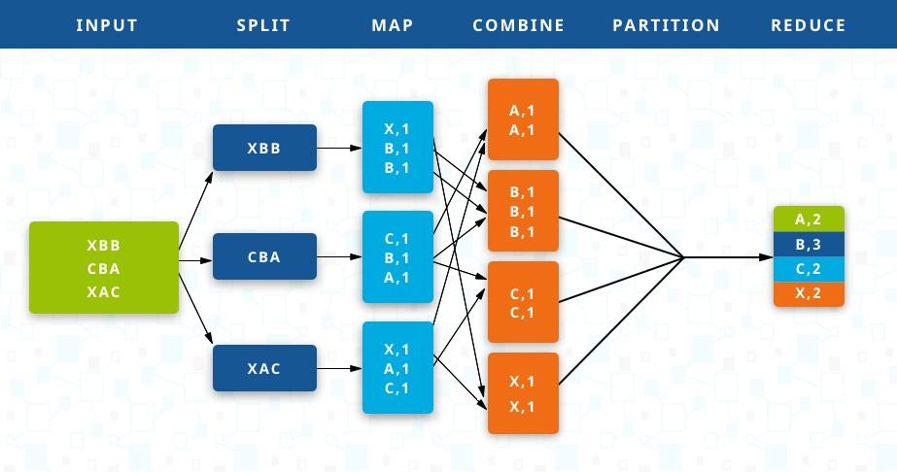

Slide 21
Mapper function

Slide 22
The input data format is as follows: <file_name>,<area_name>,<percentage of green cover>
So in our program, we read the data line by line, storing these three values in a list using the split function
Adding #!/usr/bin/python3 at the start of the file would make the file executable.
We also use the sys library to read input from stdin.

Slide 23
#!/usr/bin/python3
import sys
for line in sys.stdin:
line = line.strip()
words = line.split(",")

Slide 24
The percentage is the last argument according to the chosen data format.
Hence we will compare its value with the threshold (50%) and print either (“G”,1) denoting green area with count 1 or (“C”, 1) denoting area with less greenery with count 1

Slide 25
#!/usr/bin/python3
import sys
for line in sys.stdin:
line = line.strip()
words = line.split(",")
if (float(words[len(words) - 1]) > 50):
print("G", 1)
else:
print("C", 1)

Slide 26
Reducer function

Slide 27
The reducer function acts on the tuples produced by the mapper function which are grouped by hadoop
The input data format is as follows : “G/C” 1
We need to count the number of G’s and C’s. This can be done by adding up their count values (second word in each line of input)

Slide 28
The program will run through each line of the input, and the current tuple is compared with the previous tuple. If they’re the same, then the count variable is incremented.
When the current tuple is different from the previous tuple, the previous tuple’s count has been found out and the count variable is initialised to one for the current tuple.

Slide 29
#!/usr/bin/python3
import sys
current_word = None
current_count = 0
word = None
for line in sys.stdin:
line = line.strip()
word,count = line.split()
count = int(count)
if (current_word == word):
current_count += count
else:
if current_word:
print(current_word, current_count)
current_count = count
current_word = word
if current_word == word:
print(current_word, current_count)

Slide 30
Here,
1.current_word is used to store the previous tuple
2.current_count is used to store the count of the previous tuple
3.word,count will store “G/C” and 1 respectively.
4.The count variable is used to make the program more generic, even though in this application, it will always be 1.

Slide 31
After running the reducer program on our dataset, we got the following output.
('C', 28)
('G', 8)
This means that there were 8 areas with green cover over 50%, and 28 areas that didn’t meet the criteria.

Slide 32
Hadoop

Slide 33
Hadoop is an open source software framework used for distributed computing.
In projects that involve processing of large amounts of data, Hadoop can help in parallelizing this process by dividing the work between several nodes(computers). And it uses a master-slave architecture.
Notes:
Suppose you’ve to find the 10 most frequently occuring words in a book, and you approach this problem by trying to count the frequencies of every word in the book. This is your map function which will ‘map’ the words with their count. But the number of words in the book is too high. So you decide to distribute the task between 26 nodes, each one counting the words beginning with a unique alphabet. So master node will read a word from the book and assign it to one of the 26 nodes. At the end of the Map job, we have the frequencies of all words but now we have to reduce that result to the top 10 popular words. The reducer function does that.

Slide 34
Loading the data into HDFS

Slide 35
We have created a single node system in Hadoop on our system by installing Hadoop in the Ubuntu VM.
Hadoop Distributed File System: In our local PC, by default the block size in Hard Disk is 4KB. When we install Hadoop, the HDFS by default changes the block size to 64 MB. Since it is used to store huge data. We can also change the block size to 128 MB. Also, Hadoop stores three copies of every dataset at three different locations. This ensures that the Hadoop is not prone to single point of failure.
We need to load our input data containing the area names with green cover percentage into the HDFS (Hadoop Distributed File System)
command: hdfs dfs -put source_directory hadoop_destination_directory
Notes:
Namenodes: Run on the master node, and store metadata (data about data) like file path, the number of blocks, block Ids. etc.
Datanodes: Run on slave nodes.

Slide 36
Next, we will locate the hadoop streaming jar on the terminal to copy its path
Notes:
Hadoop Streaming is a generic API which allows writing Mappers and Reduces in any language.

Slide 37
We will now run the map-reduce job using the following command
Hadoop jar /usr/local/hadoop/share/hadoop/tools/lib/hadoop-streaming-2.7.2.jar -file /home/hduser/Downloads/task3/mapper.py -mapper mapper.py -file /home/hduser/Downloads/task3/reducer.py -reducer reducer.py -input /Input/data.txt -output /home/hduser/Downloads/task3
Notes:
There are three components in this command- the streaming API, followed by the mapper file which sends its output to the reducer which then sends its output to a new file.
-file tells you which all files are involved in the process.

Slide 38
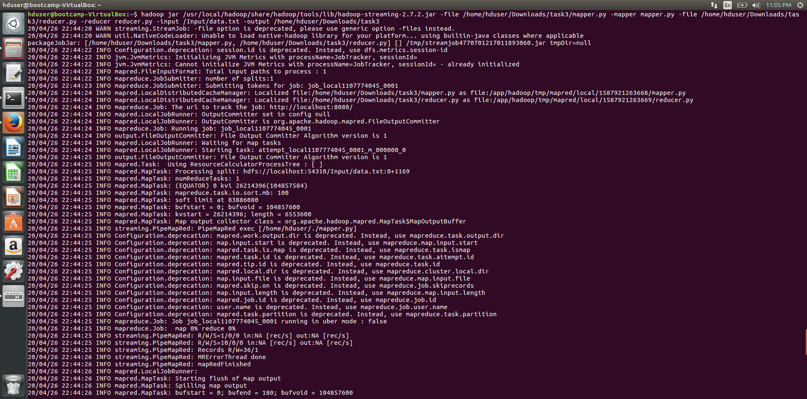
On the terminal

Slide 39
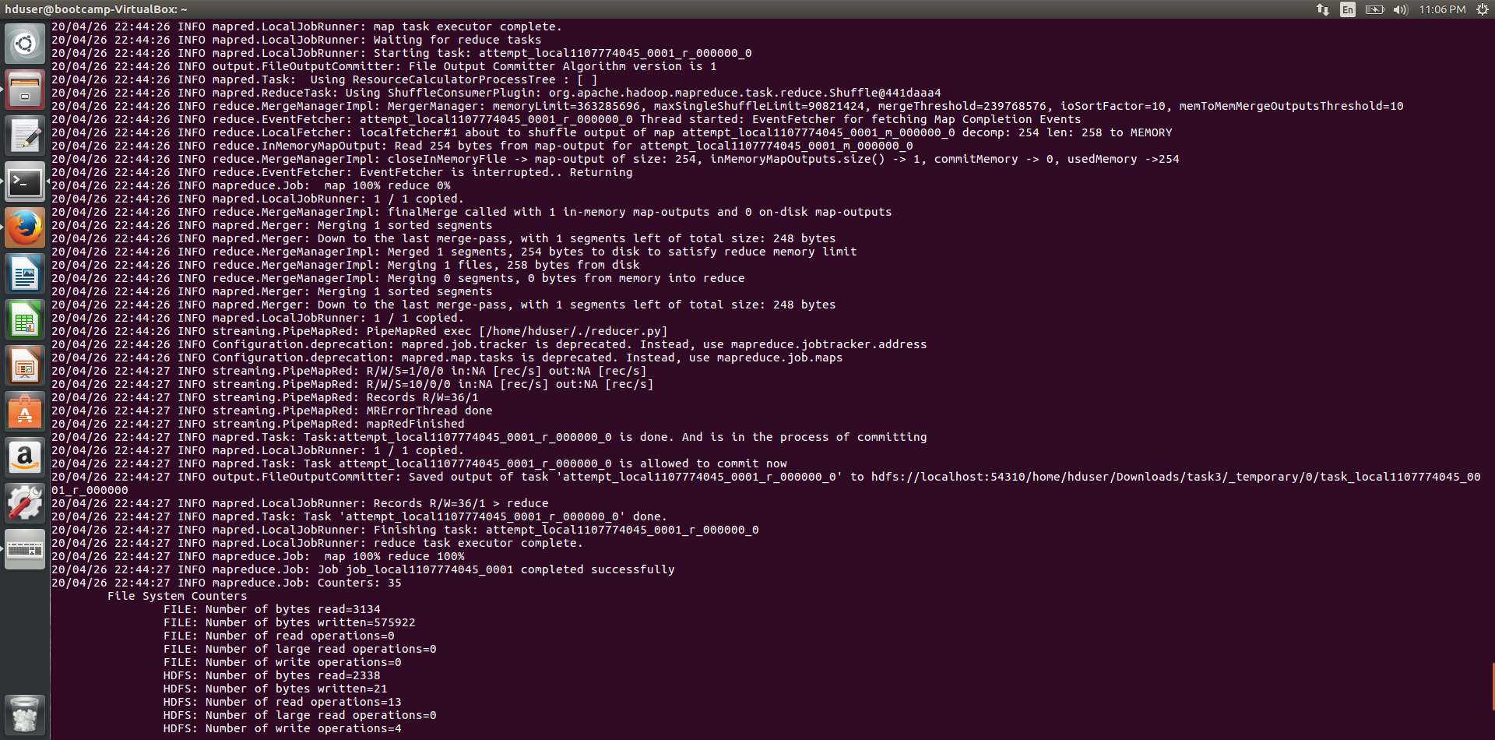

Slide 40
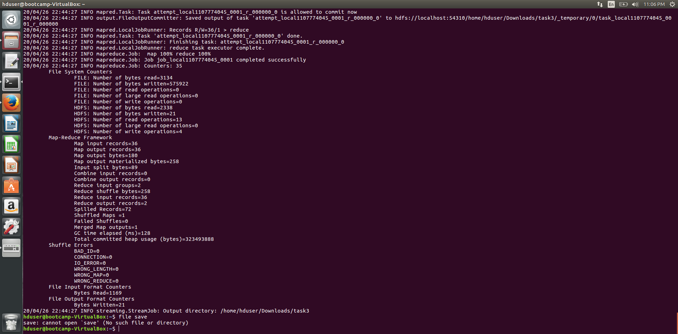

Slide 41
OUTPUT
('C', 28)
('G', 8)

Slide 42
Green areas identified by our opencv program (examples)

Slide 43
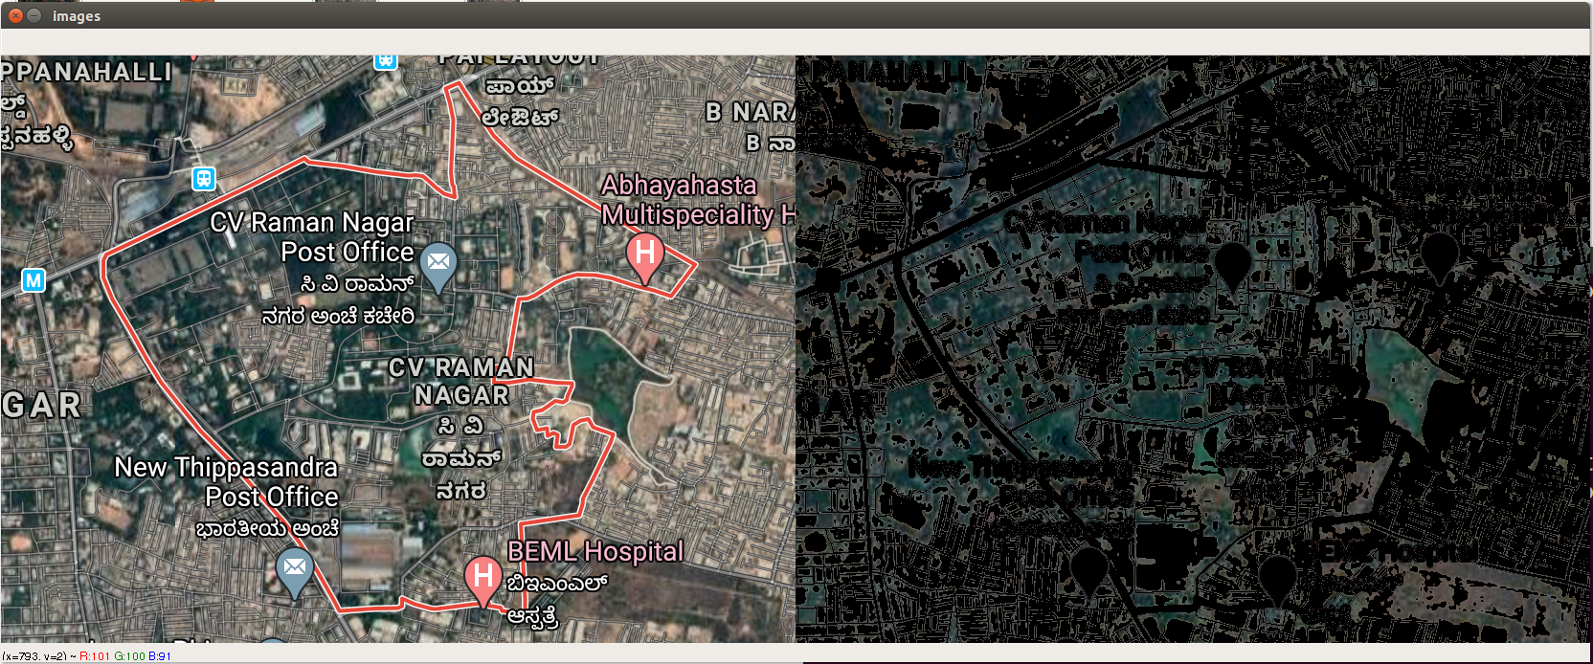
CV Raman Nagar

Slide 44
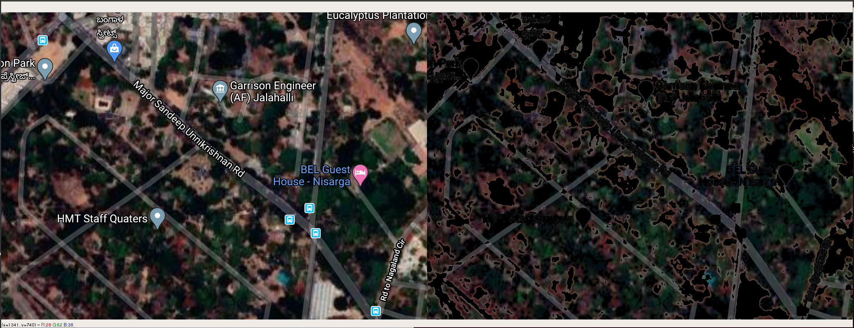
BEL Road

Slide 45
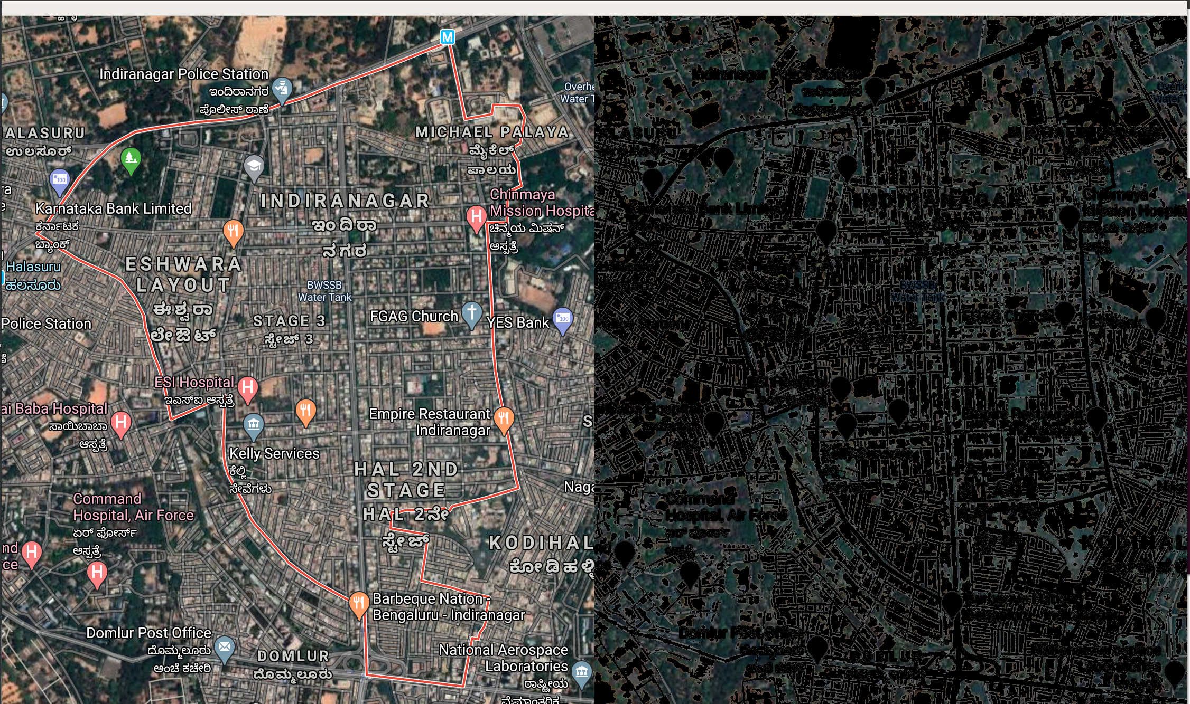
Indiranagar

Slide 46
Thank you

